Slide 1
Producathon 2020 Automotive User Profiling and Updating System
Team Leader:
Team Member 1:
Team Member 2:
College / University Name:

Slide 2
Contents
Idea Snapshot
Business Canvas
Block Diagram
Working Mechanism
Prototype Video

Slide 3



Idea Snapshot
Big vision
For automobile users to save their time in personalising the interior adjustments and make it effortless, our innovation offers automated profile based personalisation of interiors by recognising the user.
Core Pain
What are the top 3-5 problems you are solving for your customers?
Different users prefer to have different steering wheel and mirrors adjustment.
User needs to adjust the seats manually every time.
The Ambient lights need to be manually changed by the user every time for different user.
The entertainment system does not recommend the songs as per the driver’s/user’s selection.
Pain Killer*
What is the general concept/idea to make your customers happy?
Recognizing the user based on stored profile details and updating seating and interiors adjustments accordingly.

Slide 4
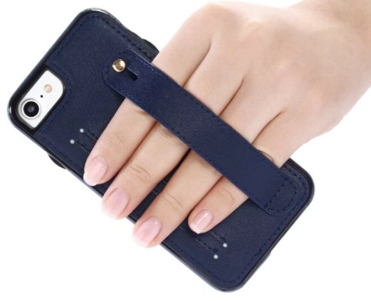
Idea Snapshot (Example for explanation purpose only)
Big vision
For smart phone user, facing issue of damaging the phone due by frequently dropping it ,our innovation offers a simple way to achieve better grip by a back cover with added utility of holding strap.
Core Pain
What are the top 2 – 4 problems you are solving for your customers?
Big screen size of mobiles creates difficulties in handling
No proper grip available due to high surface finish and slim design
Pain Killer*
What is the general concept/idea to make your customers happy?
Phone back cover with added utility of holding strap which provides proper grip and keeps phone safe from any fall damage.
Image Source: Internet

Slide 5







Business Canvas
Strategic Fit
Unique Value Proposition
Ideal Customer*
Family Car having multiple users.
Autonomous Car Users.
Luxury Car Users.
Preference for automated controls over manual controls in future market.
Competitors are Mercedes Benz, Johnson Controls, Audi, BMW.
Users need to Adjust their Seat, Side Mirrors, Steering Wheel Position manually which is very tedious and irritating in an urgency.
Our Innovation stores user’s adjustments(seats ,etc.) for very first time and accordingly detects(face recognition)the user and automates the adjustment process in future. Hence reducing the efforts and saving time.
1
Use-Cases*
Initially new user needs to input the adjustments for the first time.
If system recognizes the user it automatically adjust the interiors else considers the user as new user.
Key Risks
Existing Alternatives
Business Model
Camera has to be maintained clean to capture the face of user.
Weather Challenges for Face recognition.
Circuit Complexity.
The Existing solutions are Memory Buttons or Memory Seats which stores at most 3 users adjustments.
Main focus on comfort and to nullify manual work.
Expenses of electronics components
Can be upgraded as per future needs.
Collaboration with automotive OEMs.
Tie-up with autonomous vehicle manufacturers.
5
5acXjzUk
Notes:
How you can add cost value?

Slide 6
Business Canvas
Strategic Fit
Unique Value Proposition
Ideal Customer*
Family Car having multiple users.
Autonomous Car Users.
Luxury Car Users.
Preference for automated controls over manual controls in future market.
Competitors are Mercedes Benz, Johnson Controls, Audi, BMW.
Users need to Adjust their Seat, Side Mirrors, Steering Wheel Position manually which is very tedious and irritating in an urgency.
The existing system have Memory seats which needs to be set manually every time and maximum users can set are 2-3. Our Innovation can store users data depending on the memory size. It stores his/her adjustments for very first time using facial recognition and accordingly detects the profile in future. Hence reducing the efforts and saving t
1
Use-Cases*
Initially new user needs to input the adjustments for the first time.
If system recognizes the user it automatically adjust the interiors else considers the user as new user.
Key Risks
Existing Alternatives
Business Model
Camera has to be maintained clean to capture the face of user.
Weather Challenges for Face recognition.
The Existing solutions are Memory Buttons or Memory Seats which stores at most 3 users adjustments.
Where is the added value ?
What are the cost drivers?
How this idea will make money?
X
X
X
X
X
X
x
MANDATORY for Grand Finale and Optional for pitch presentation
6
5acXjzUk
Notes:
How you can add cost value?

Slide 7
Business Canvas (Example for explanation purpose only)
Strategic Fit
Unique Value Proposition
Ideal Customer*
Smart Phone Users
Smart phone design are getting slimmer and they are with wide screens due to rapid evolving technologies.
Smart phone accessory market is huge thus lots of small scale and big scale competitors,
OEM’s prefers to focus on phones itself rather than such accessories.
Possible loss of competitive advantage
Better safety of mobile phones with a simple and unique feature of holding strap for proper grip
1
Use-Cases*
People will attach the back cover to their phone and pass their hand through the holding strap
Key Risks
Existing Alternatives
Business Modell
Optimum design of strap for adequate strength
Acceptance of product by market,
Back covers made of higher friction material for better grip.
Back covers with strategic grip points.
Holding strap feature is USP
Investment in mfg. equipment and logistics network development
Bringing make cost down by mass mfg. and keeping proper margins.
Globally online selling via Amazon
Collaboration with smart phone OEMs
7
5acXjzUk

Slide 8

USER DETECTION

Slide 9

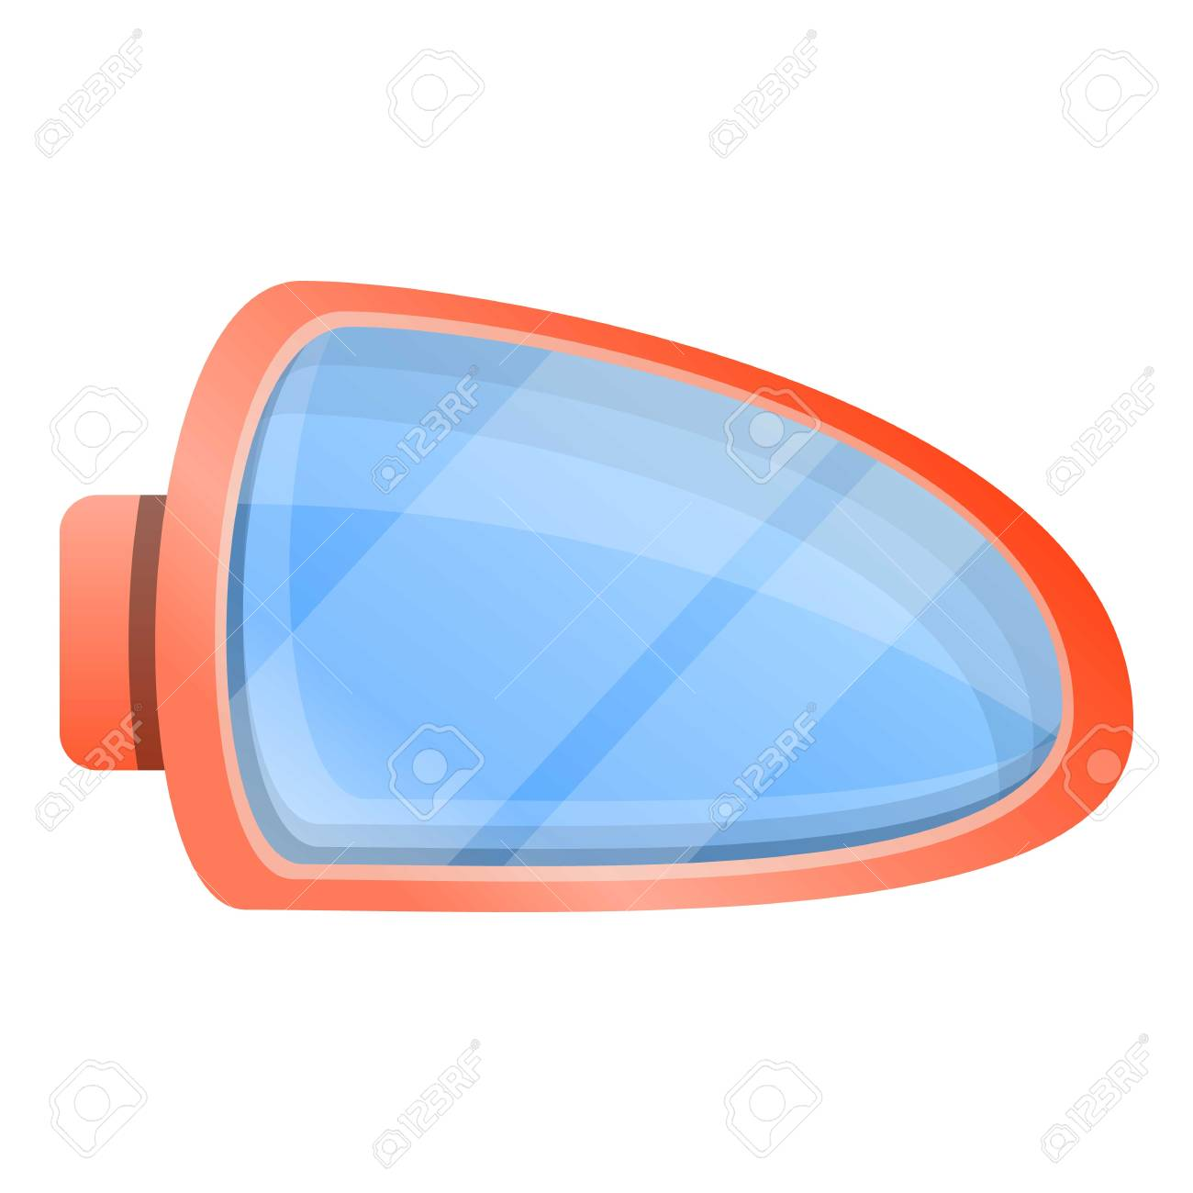

User Saved Adjustment
SEAT
AMBIENT
LIGHTING
SIDE VIEW MIRRORS
MUSIC SYSTEM

Slide 10
IF
NEW USER

Slide 11
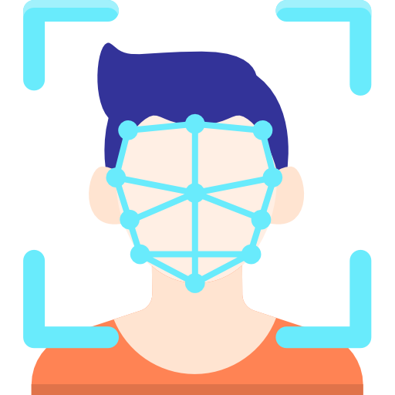
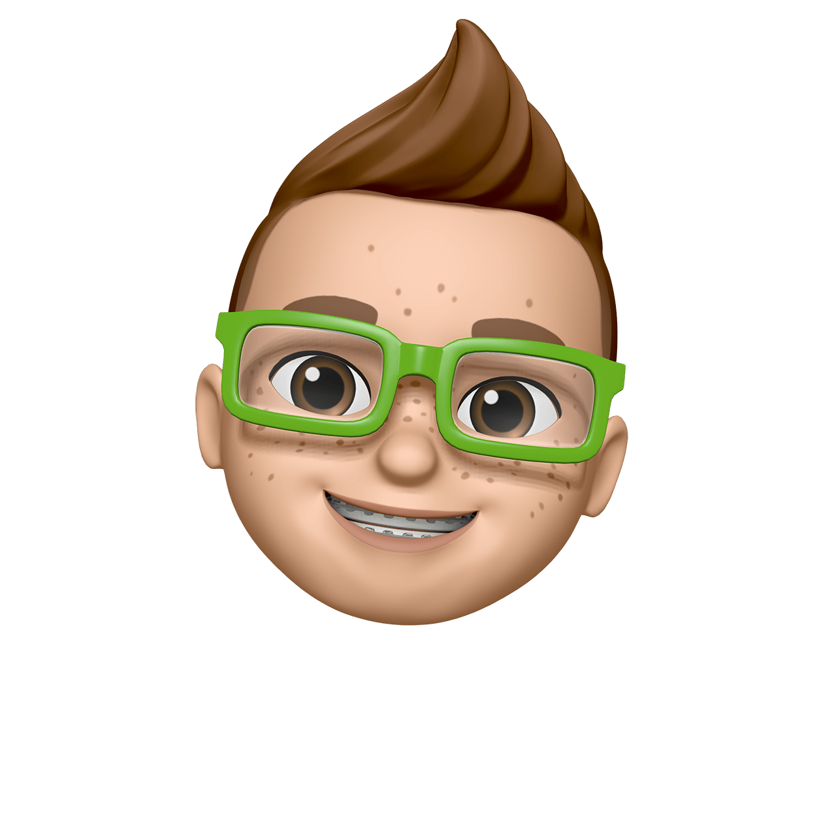
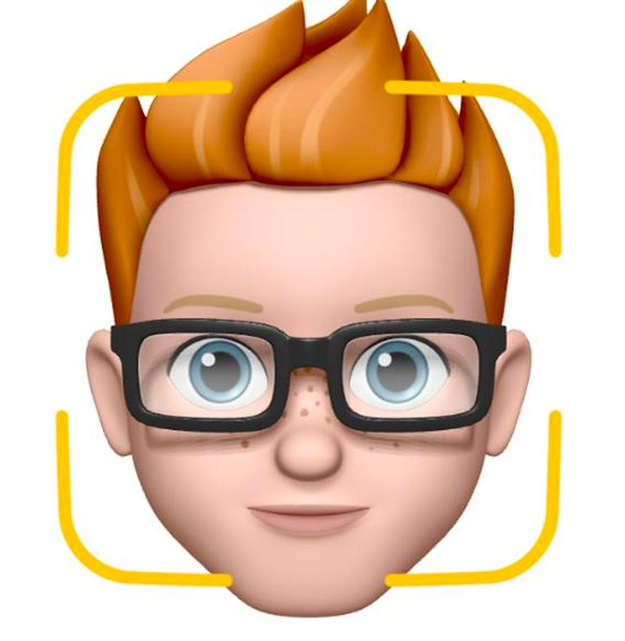
Train the Recognizer
Feed that face data and respective id’s of each face to the recognizer so that it can learn
Phase1
Phase3
Phase2
Data Gathering
Recognition
Gather face data(images) of the person to be identified
New face data(new user) is saved

Slide 12
NEW USERS ADJUSTMENT
SEAT
AMBIENT
LIGHTING
SIDE VIEW MIRRORS
MUSIC SYSTEM

Slide 13
Features:
Speech indication is provided while updating the adjustments.
The system also provides an option for the temporary users as well.
If new user is detected then the system asks whether he/she wants to register new profile.
If yes then the adjustments made are taken as input for that profile.
If no then the adjustments are left unaltered.
For connected cars the above event can be done through voice command.
The interior adjustments includes:
steering wheel position ,seats ,ambient lighting ,side view mirrors and music recommender system.
The system can be further upgraded for adjusting other functions like temperature ,ventilation ,climate control ,etc. which depends on user’s selection.

Slide 14
Student Guidelines
Slide number 2 and 4 are mandatory Slides(Idea Snapshot and Business Canvas) along with the other slides which you will be preparing for the Pitch Presentation.
You can add your own slides accordingly to make your presentation more robust and presentable.

